Slide 1
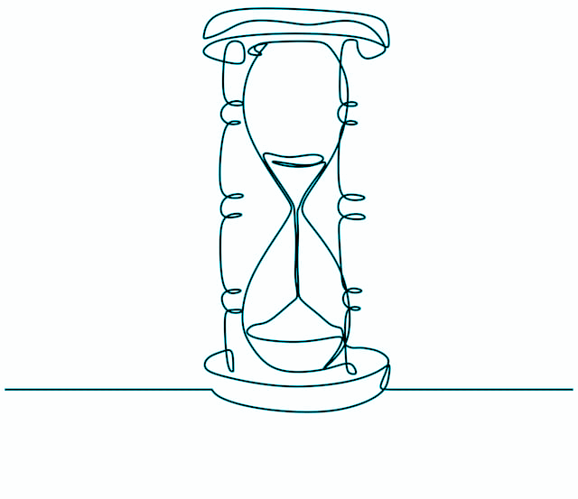
The role of the adaptive evolution on non-coding regulatory sequences during ascidian embryogenesis
Saudat Alishayeva
30/11/2021

Slide 2
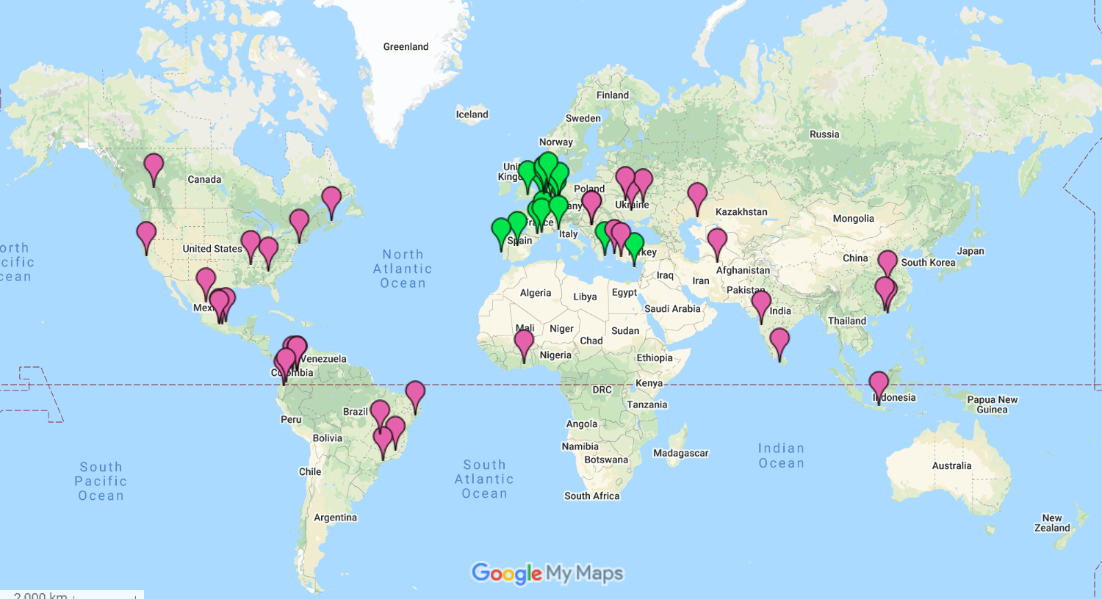
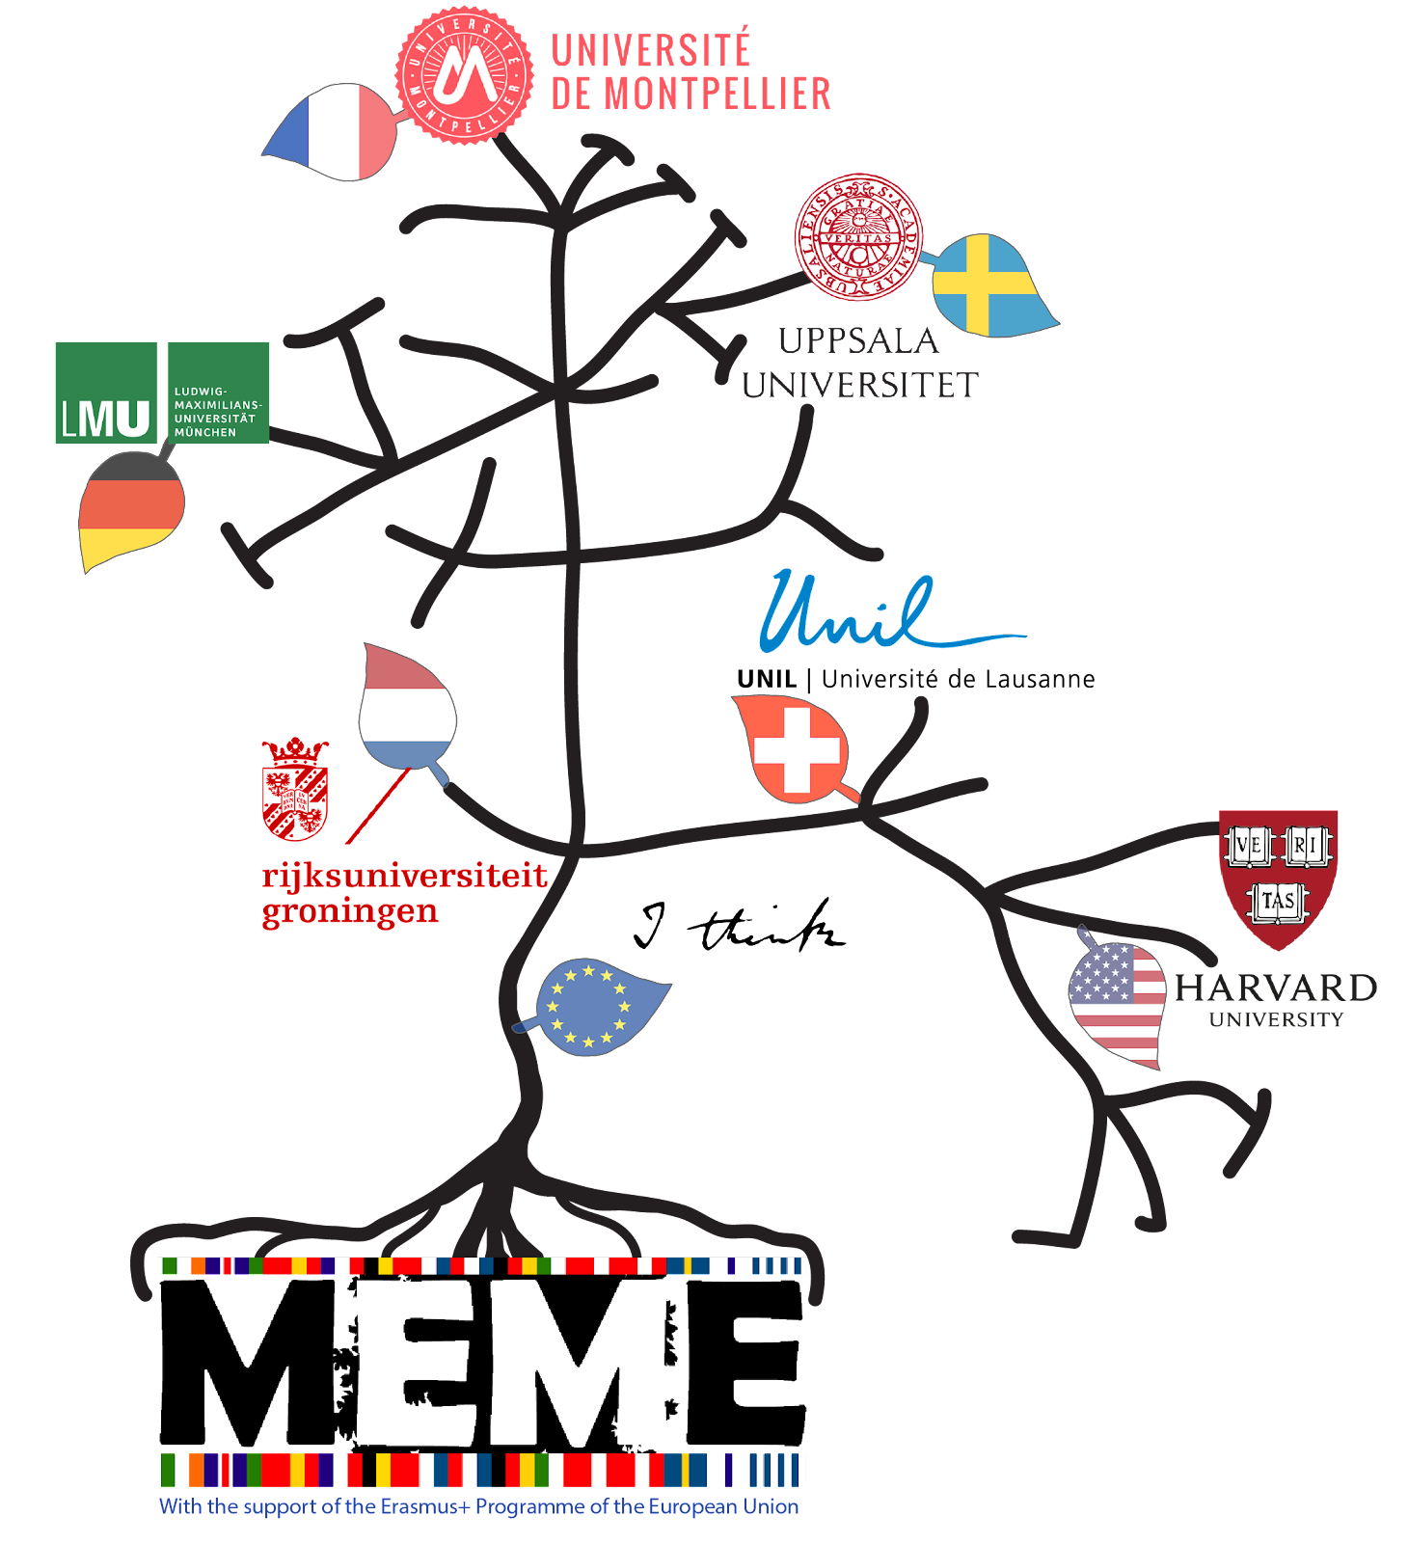
Masters Erasmus Mundus in Evolution (MEME)

Slide 3
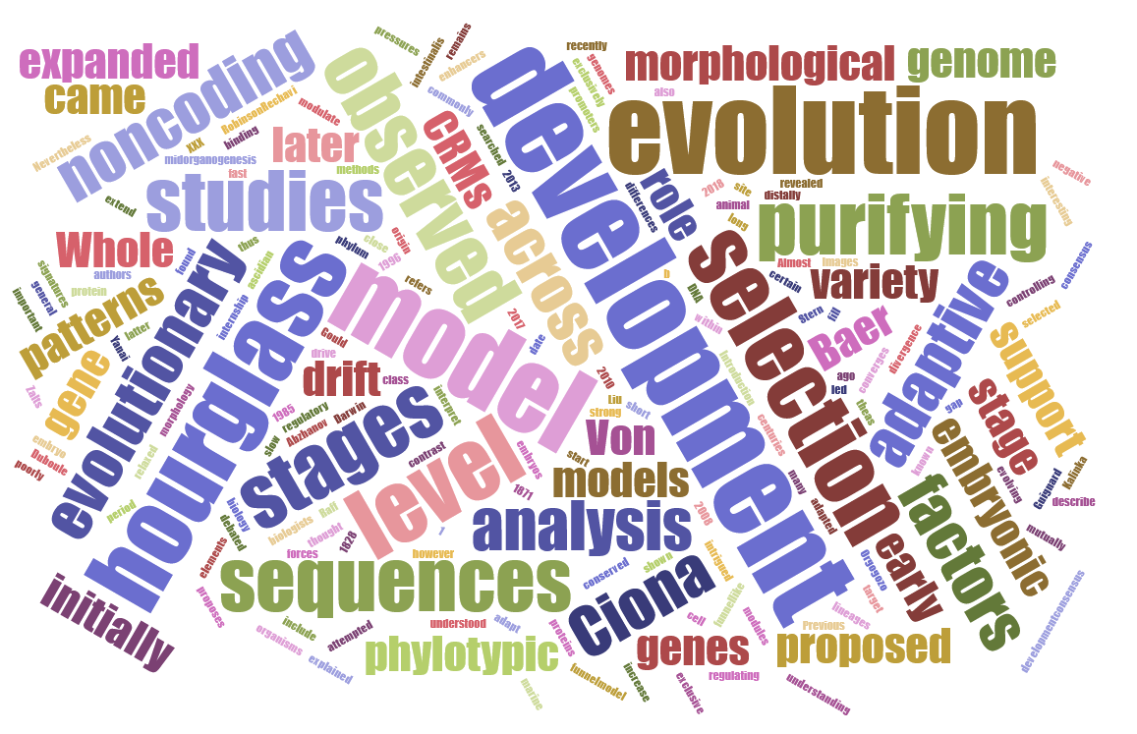

Slide 4
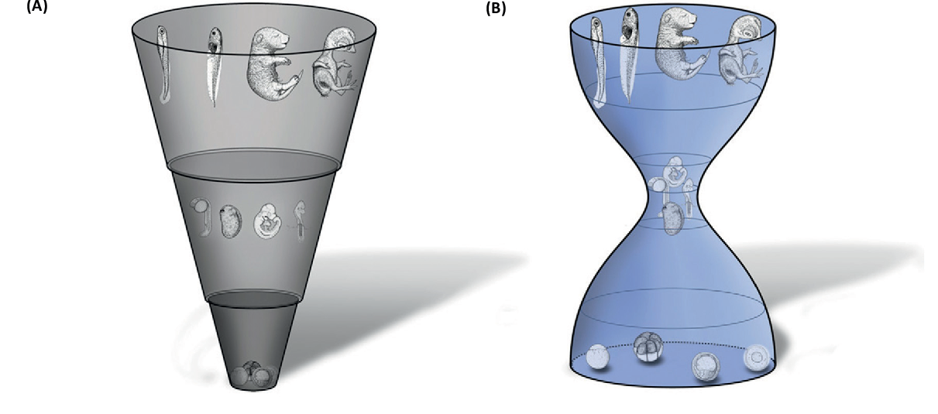
Two Models of Development
Phylotypic stage
Early Conservation Model
Hourglass Model

Slide 5
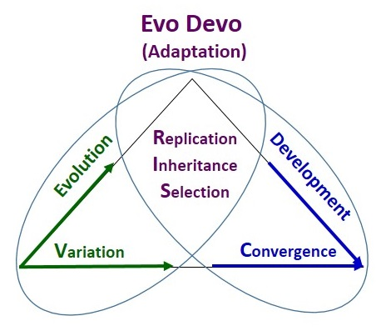
EvoDevo: Adapt and Grow
(Smart 2017)

Slide 6
EvoDevo: Adapt and Grow
(Smart 2017)

Slide 7
Why do selection/evolution matter?

Slide 8
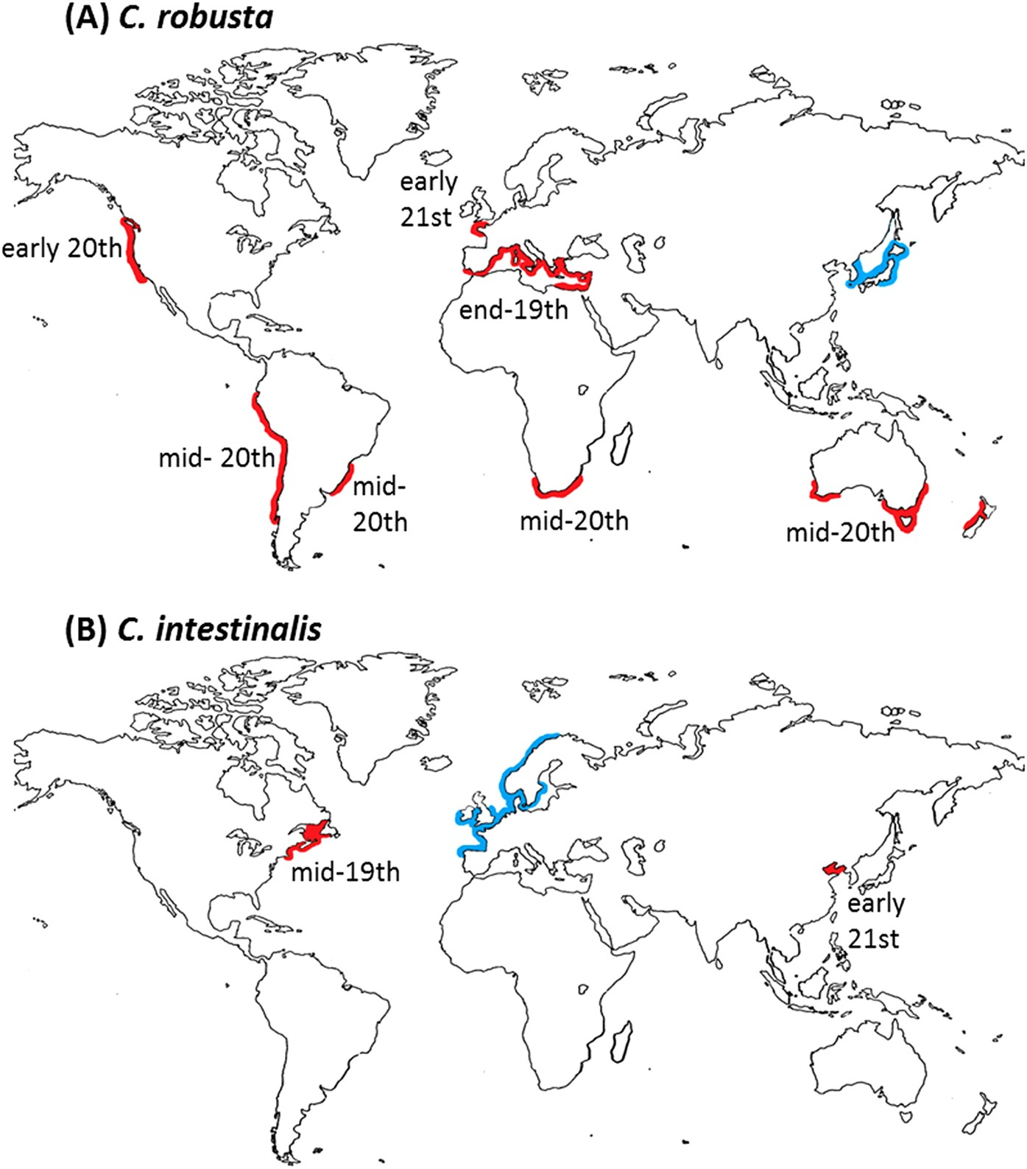
Why do selection/evolution matter?

Slide 9

Why do selection/evolution matter?

Slide 10
Why do selection/evolution matter?
Selection response tells us about how organisms can adapt to their changing environments
This is important for conservation of native species and control of invasive species

Slide 11
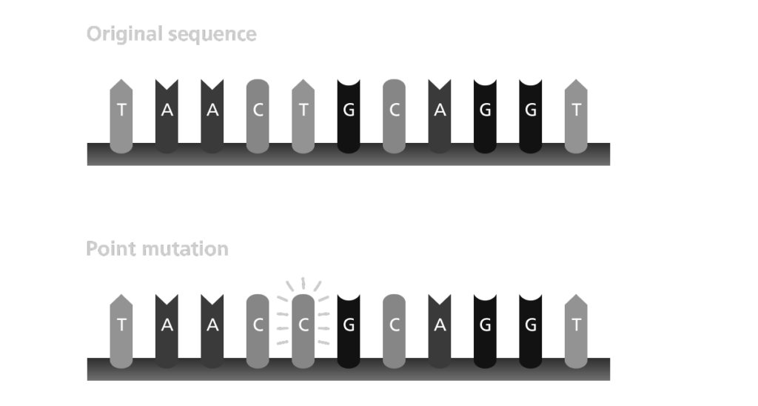
Mutations: window to the past

Slide 12
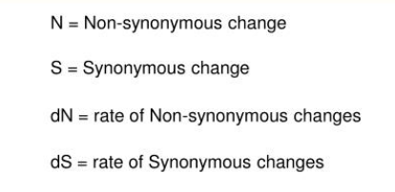
Mutations: window to the past

Slide 13
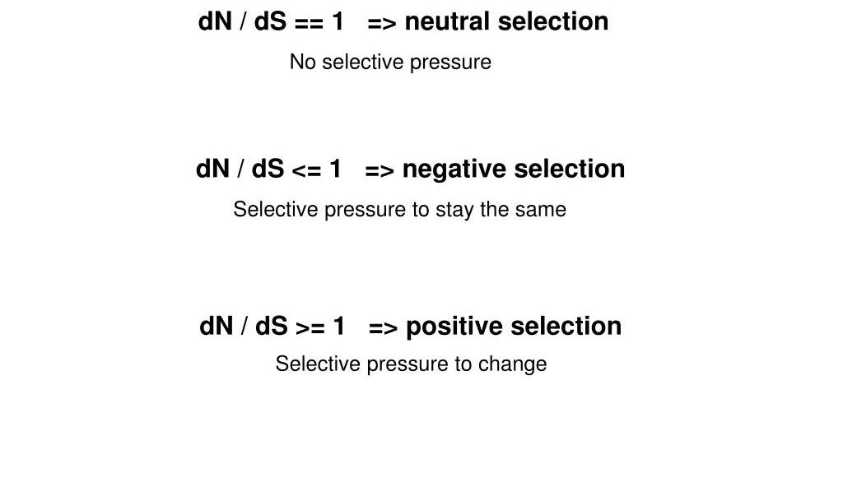
Positive Selection can be identified by mutation ratios

Slide 14
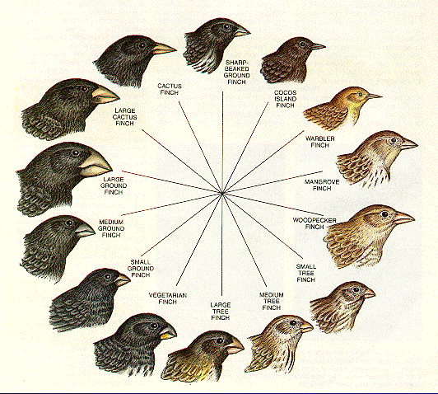
Positive Selection: we find more change than expected
Non-synonymous mutations
Synonymous mutations

Slide 15
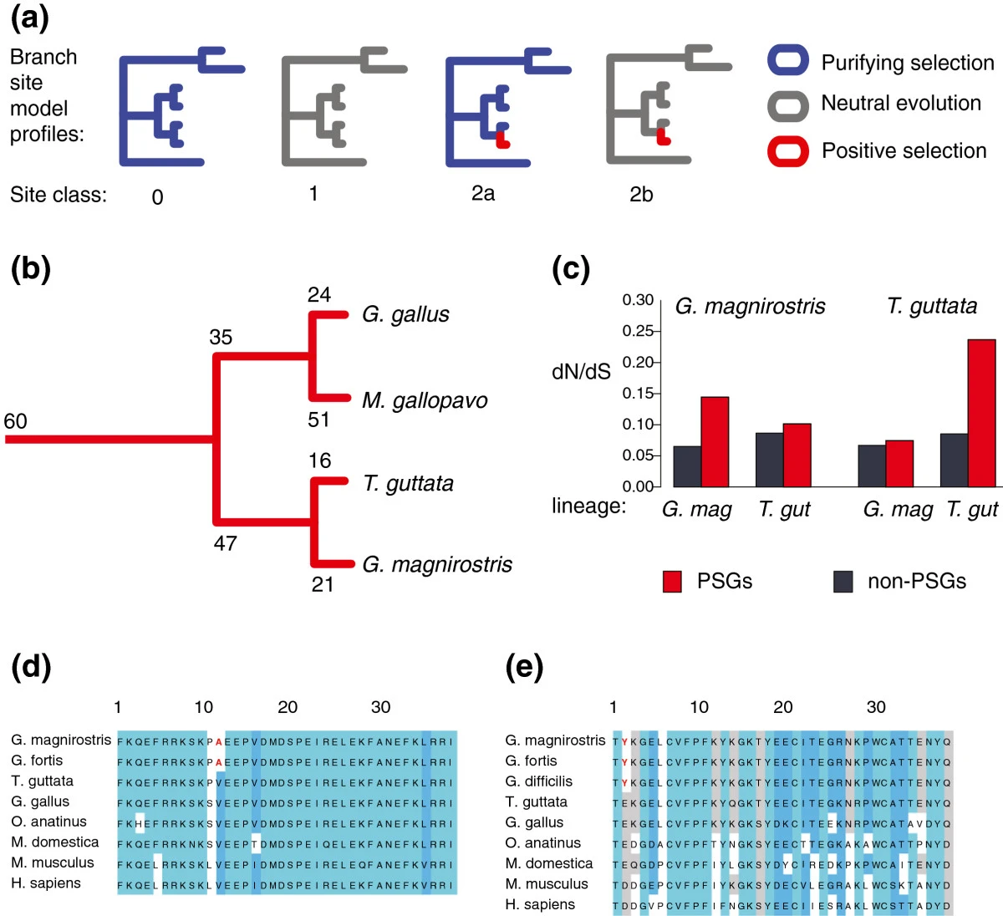
Positive Selection: when we find more change than expected
Non-synonymous mutations
Synonymous mutations

Slide 17
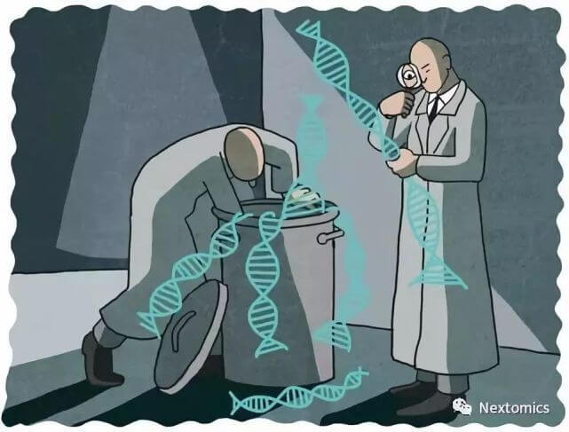
But what do we know about selection in the ‘junk’ DNA?

Slide 18
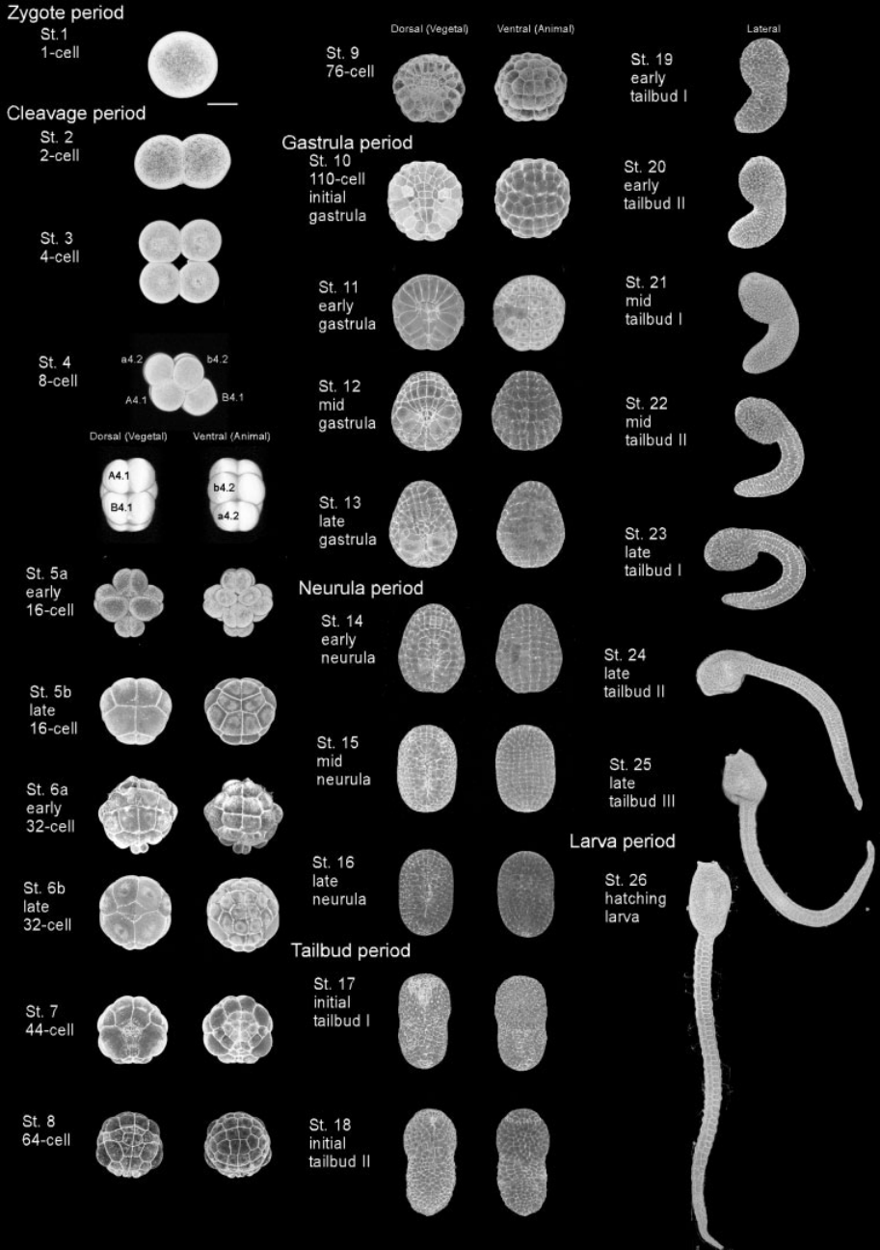
Stages of Ciona development
64-cell 112-cell Late Gastrula Mid-neurula Mid tailbud I

Slide 19
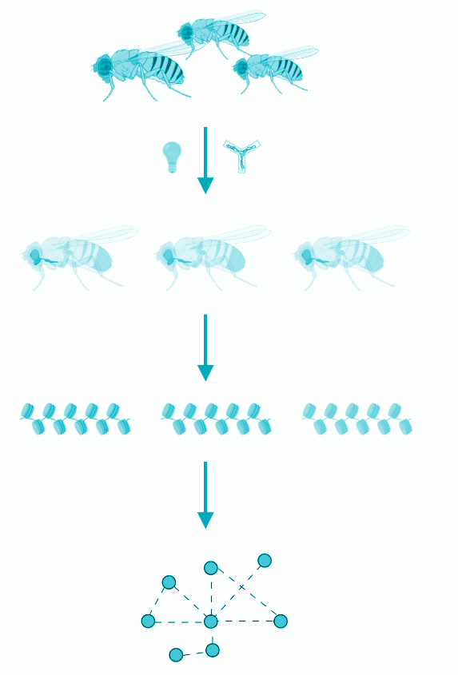
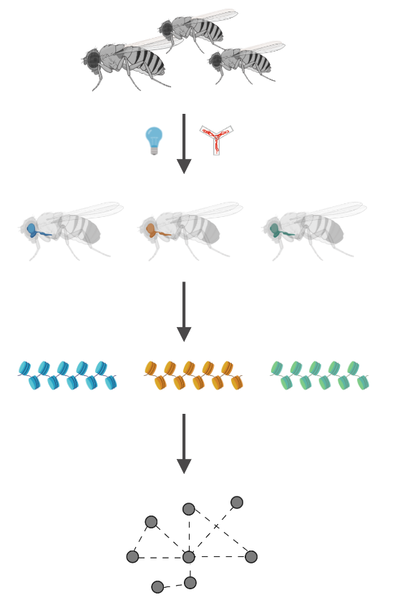
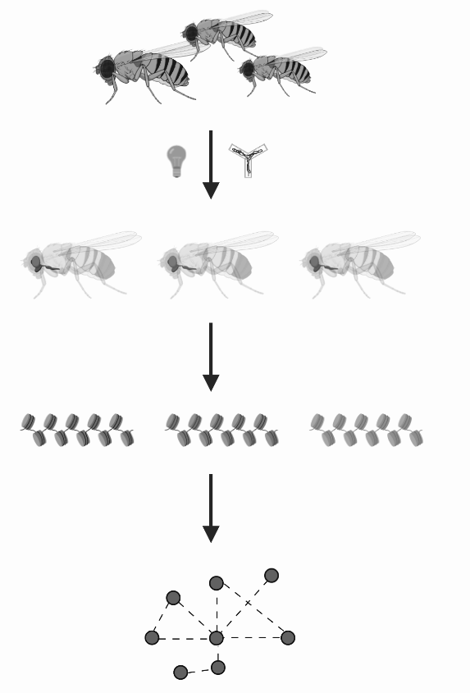
Stages of Ciona development
64-cell 112-cell Late Gastrula Mid-neurula Mid tailbud I

Slide 20
Stages of Ciona development
64-cell 112-cell Late Gastrula Mid-neurula Mid tailbud I
Questions:
Can we detect positive selection in non-coding elements during ascidian development?
Will we observe the hourglass model of positive selection at these stages?

Slide 21
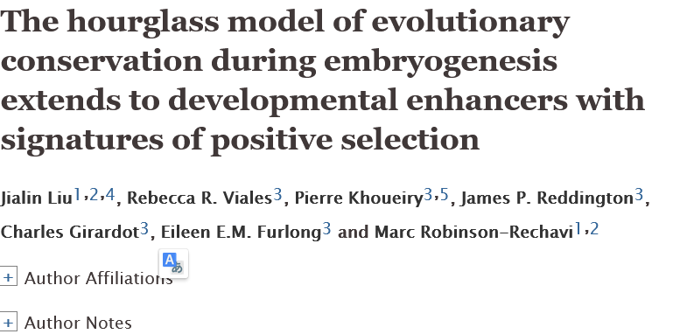

Slide 22
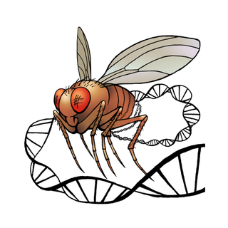

Slide 23
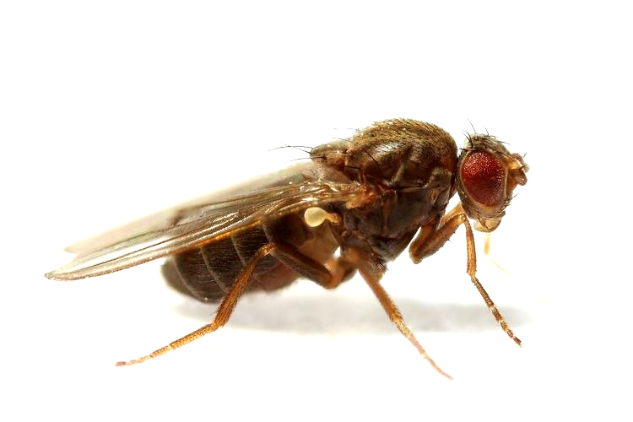
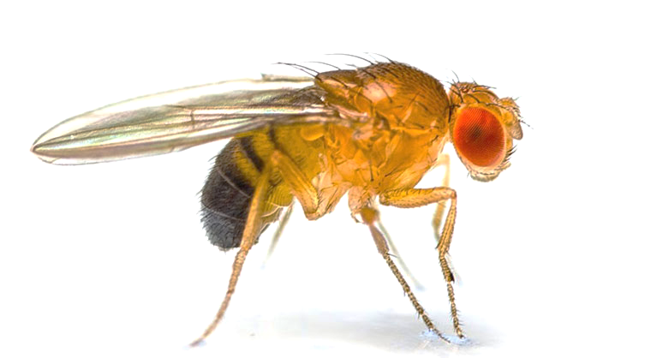

Hourglass Model of Development in Drosophila

Slide 24
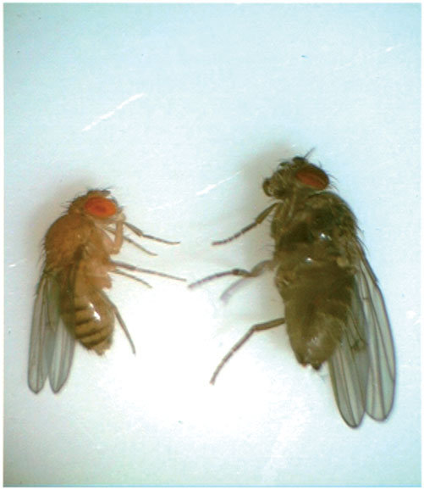
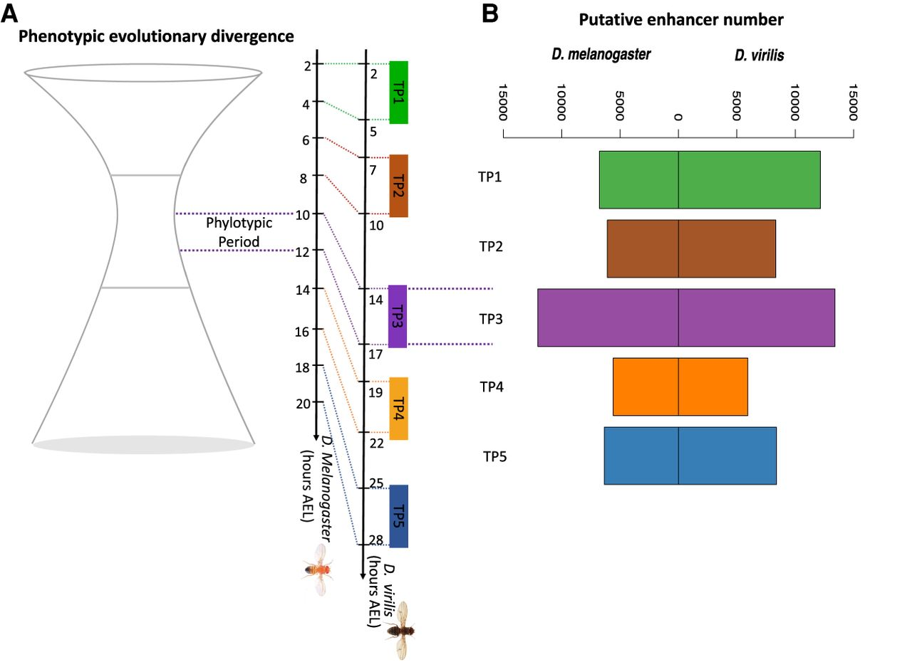
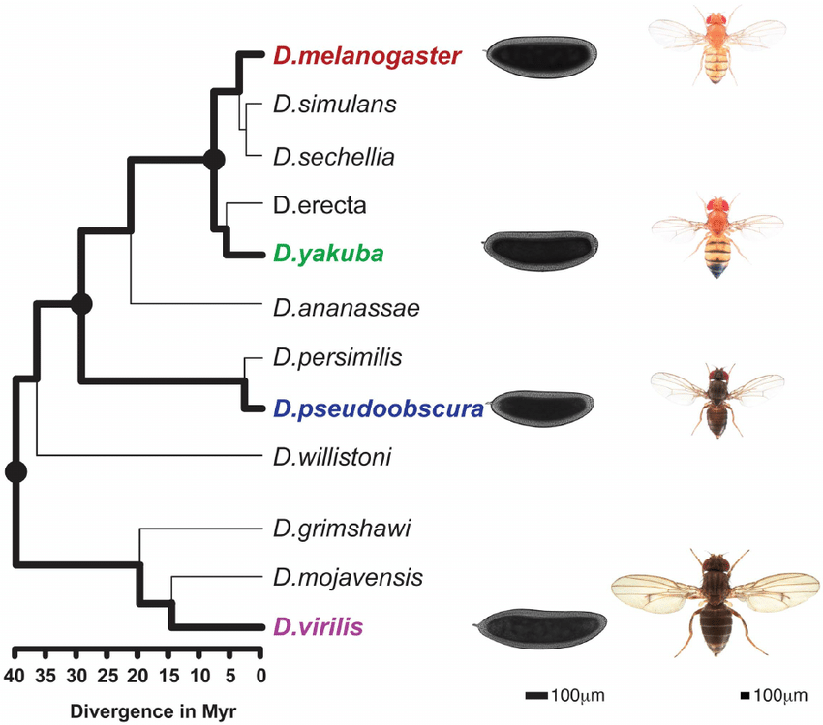
Enhancers are conserved during Phylotypic Period

Slide 25
Does positive/negative selection explain hourglass pattern of development?

Slide 26
How can we make a difference between neutral and functional mutations in regulatory genome?

Slide 27
How can we make a difference between neutral and functional mutations in regulatory genome?

Slide 28
How can we make a difference between neutral and functional mutations in regulatory genome?
In protein coding DNA we can easily calculate how many functional mutations we have because we can compare them with the rate of non-functional mutations

Slide 29
How can we make a difference between neutral and functional mutations in regulatory genome?
In protein coding DNA we can easily calculate how many functional mutations we have because we can compare them with the rate of non-functional mutations.
But what can be the ‘neutral’ or non-functional reference if we want to look at non-coding DNA?

Slide 30
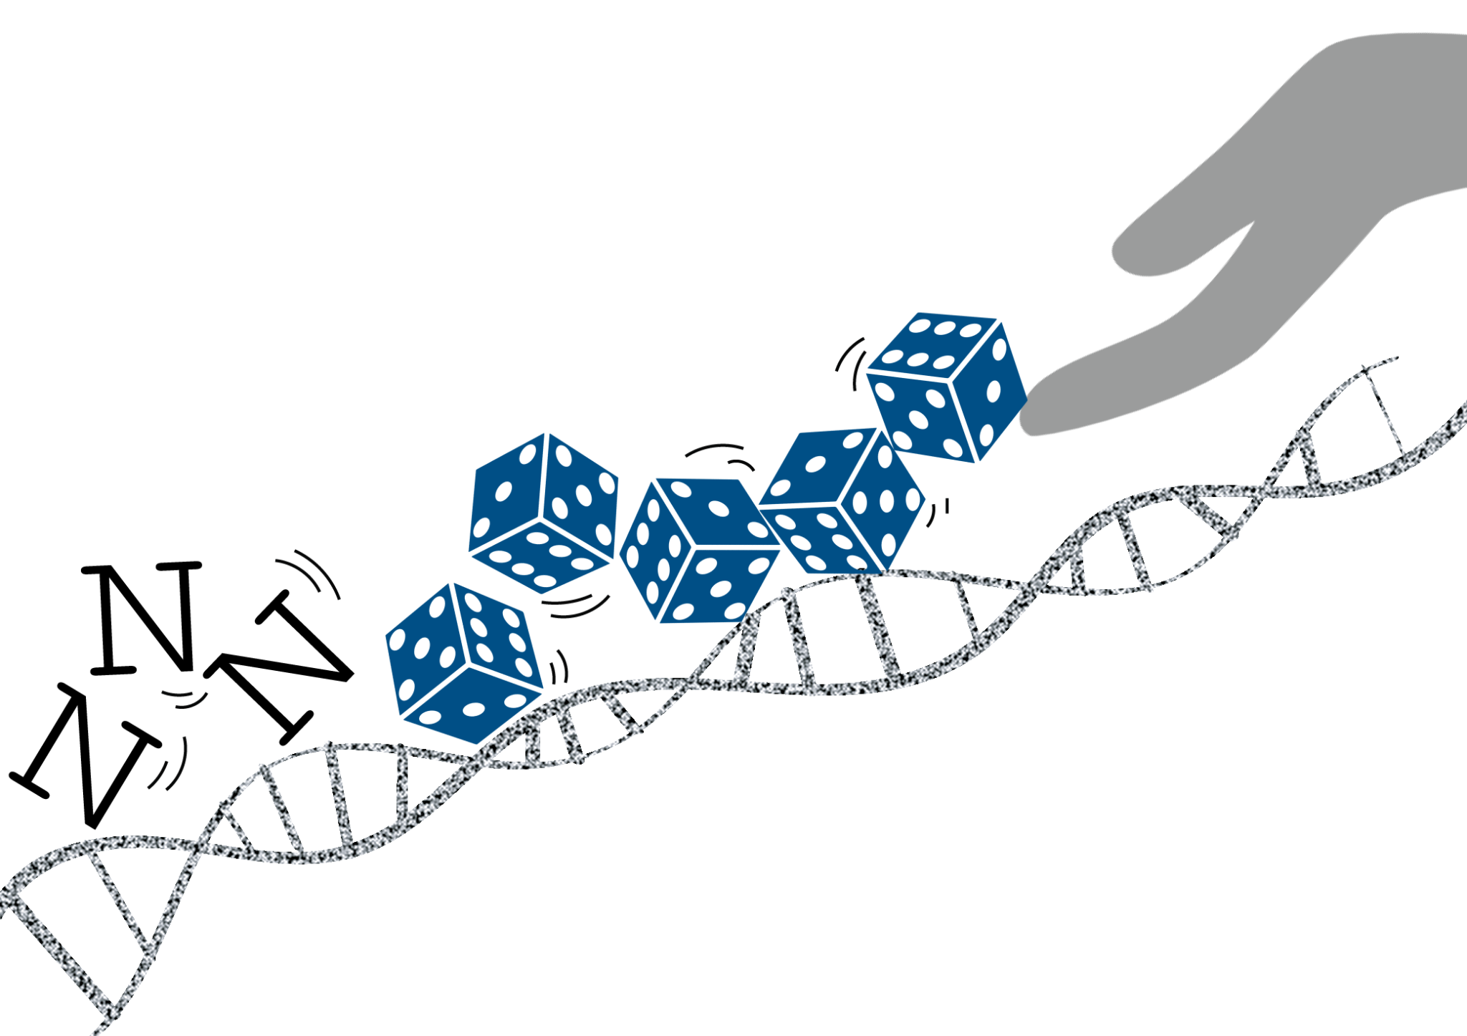
How can we make a difference between neutral and functional mutations in regulatory genome?

Slide 31
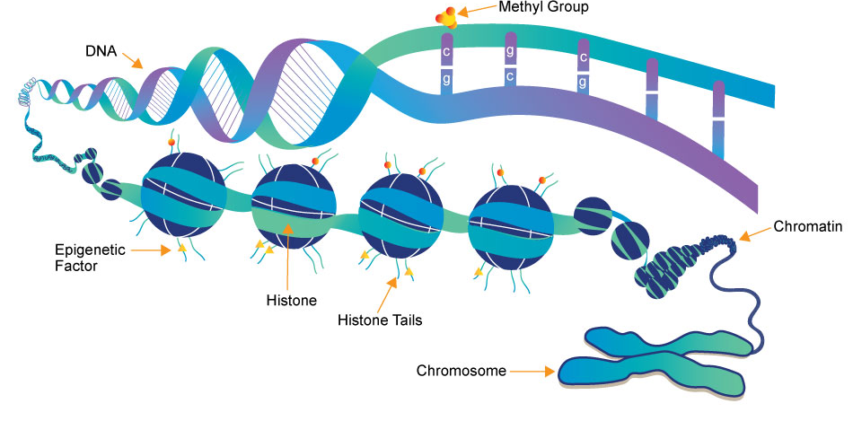
How can we make a difference between neutral and functional mutations in regulatory genome?

Slide 32

How can we make a difference between neutral and functional mutations in regulatory genome?
Random DNA
Machine Learning
Regulatory DNA

Slide 33
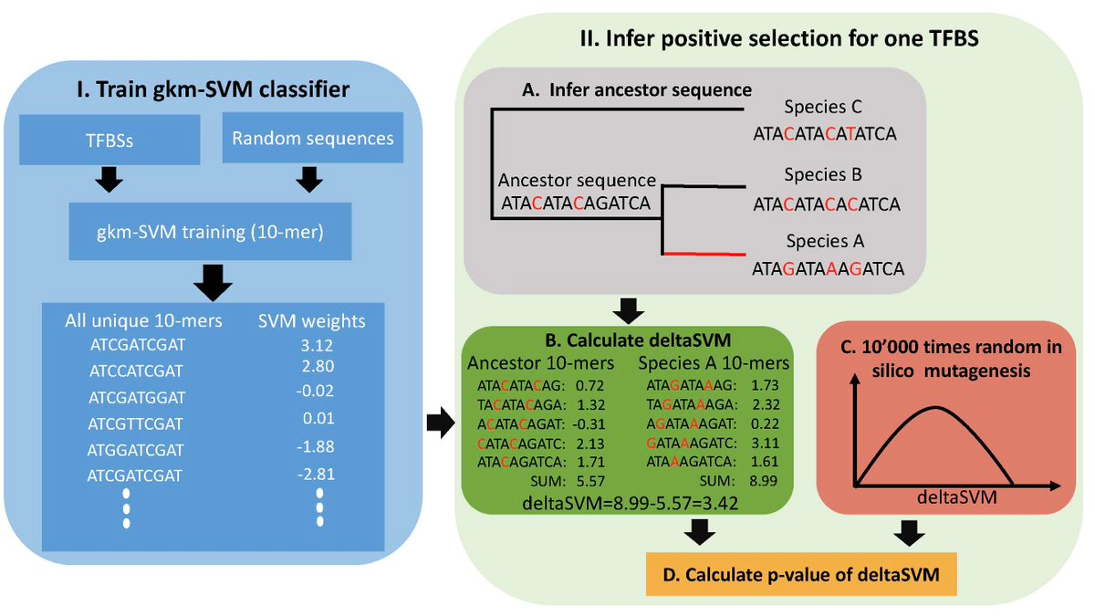
Positive selection analysis in non-coding DNA:

Slide 34
How to study positive selection:
Step 1: Find stage-specific regulatory elements (using ATAC/DNA-seq data)
Step 2: Generate random enhancer sequences
Step 3: Check if algorithm can recognize stage-specific sequences
Step 4: Train the model on ancestral & sister-species genomes
Ta da!

Slide 35
To calculate positive selection we also need some ancestral genome information
~ 3 MYA

Slide 36
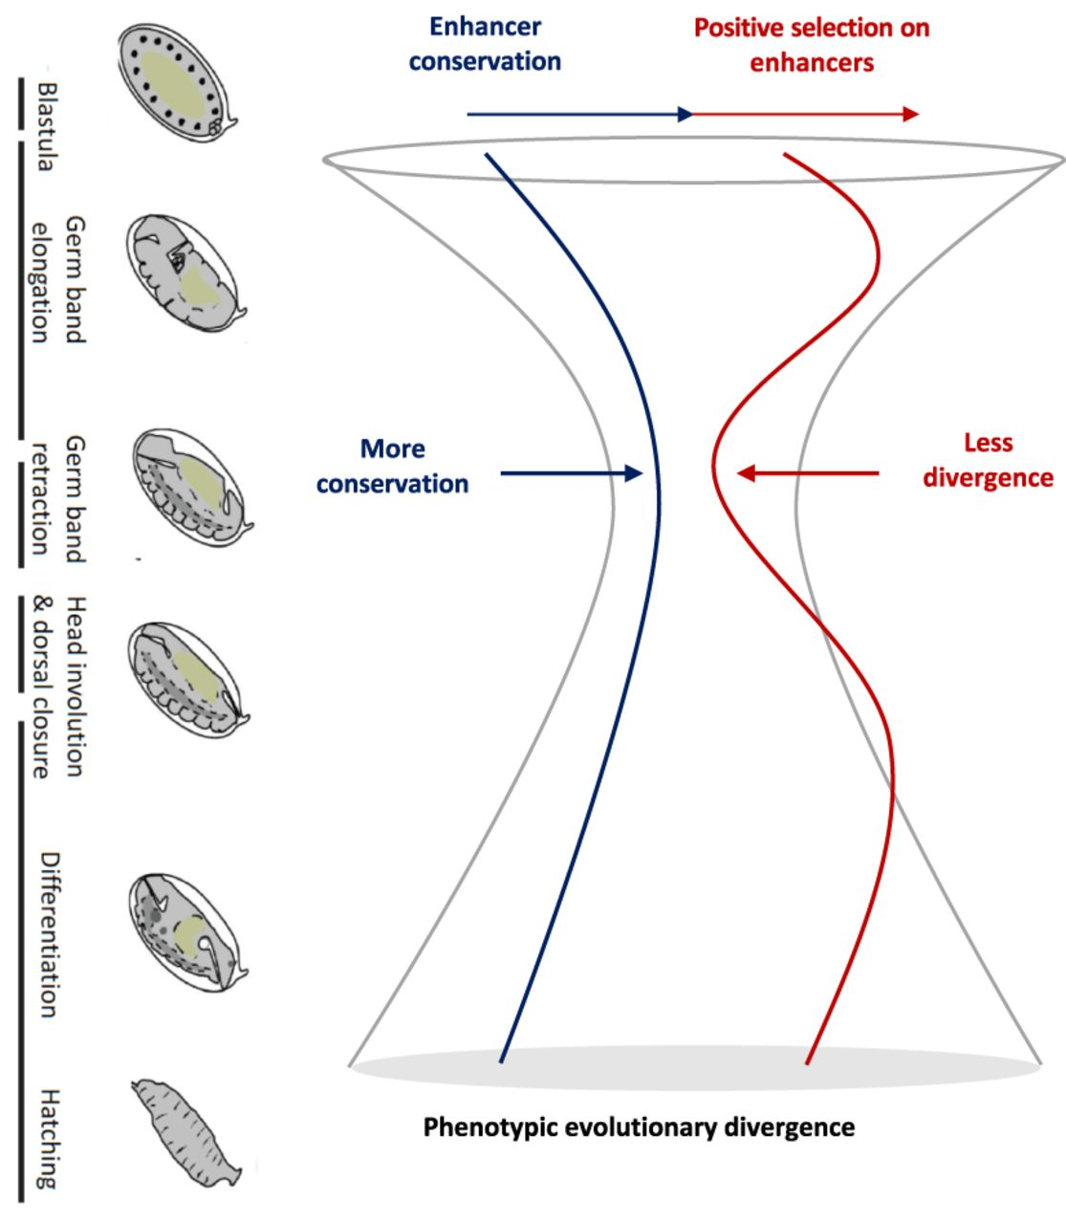
Does positive/negative selection explain hourglass pattern of development?
~ 3 MYA

Slide 37

How does machine learning (SVM) work?

Slide 38
How to study positive selection:
Step 1: Find stage-specific regulatory elements (using ATAC/DNA-seq data)
Step 2: Generate random enhancer sequences
Step 3: Check if algorithm can recognize stage-specific sequences
Step 4: Reconstruct the ancestral genome
Step 5: Train the model on ancestral & sister-species genomes
Ta da!

Slide 39
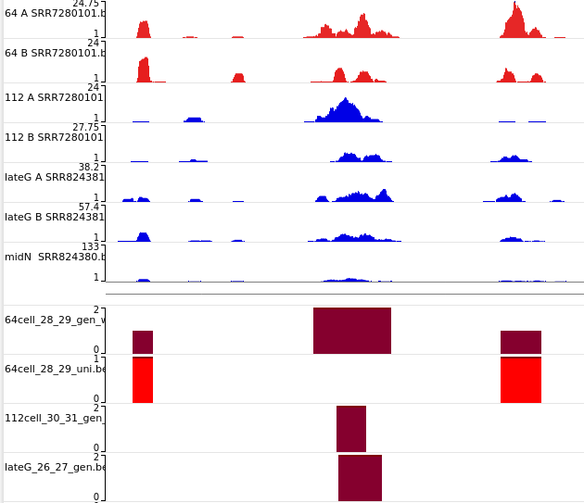
Step 1: Find stage-specific regulatory elements
Peaks show where the chromatin is accessible
Peaks should be present in two biological replicas for the same stage
Should not be present in other stages

Slide 40

Step 2: Generate Random sequences

Slide 41
Step 2: Generate Random sequences
Must have in common:
Length distribution
GC content
Short tandem repeats

Slide 42
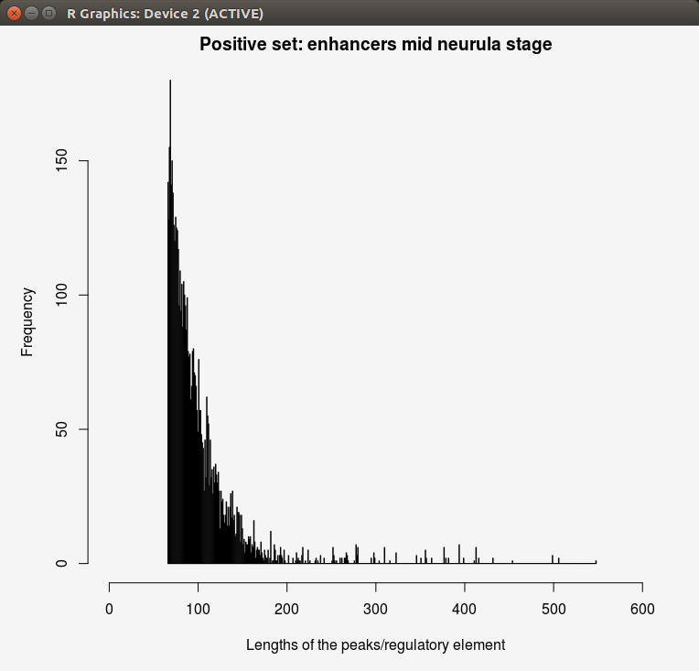

Controlled randomness:

Slide 43
Controlled randomness:
GC content: 64%
GC content: 64%
Tandem repeats: 742
Tandem repeats: 1004

Slide 44
Step 3: Check if algorithm can recognize stage-specific regulatory sequences

Slide 45
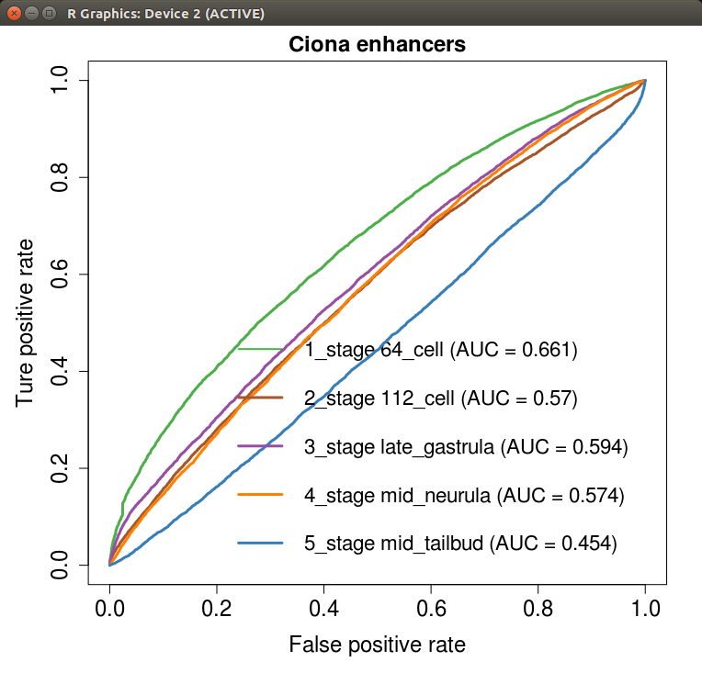
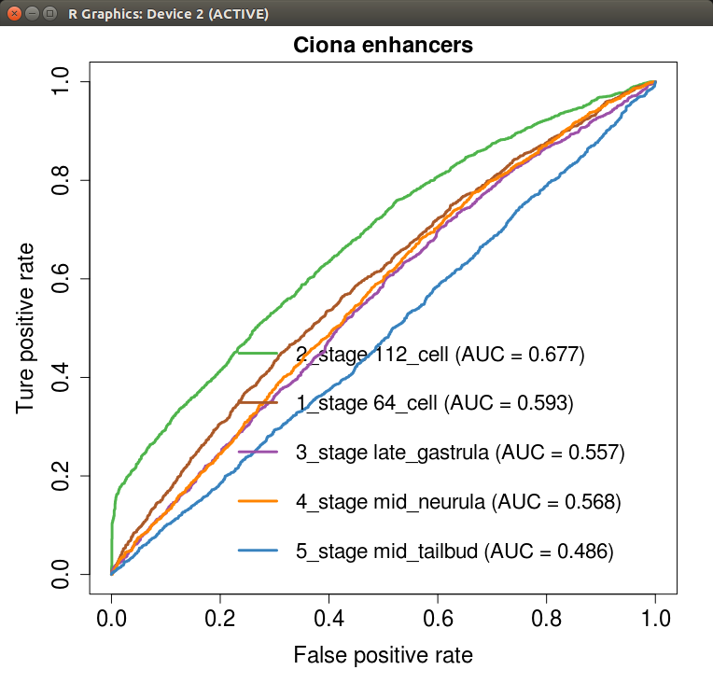
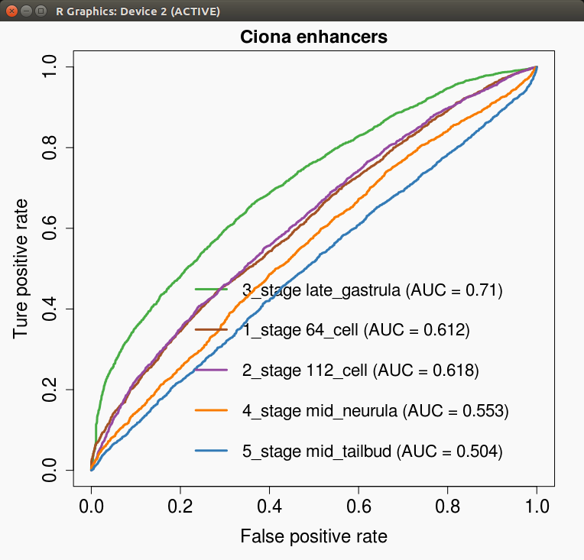
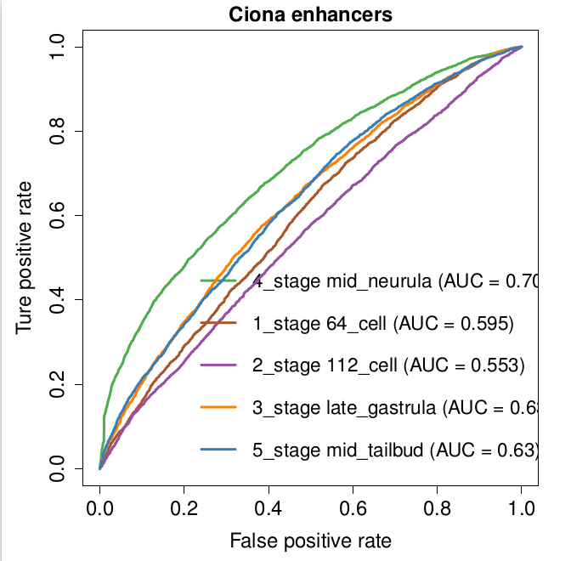
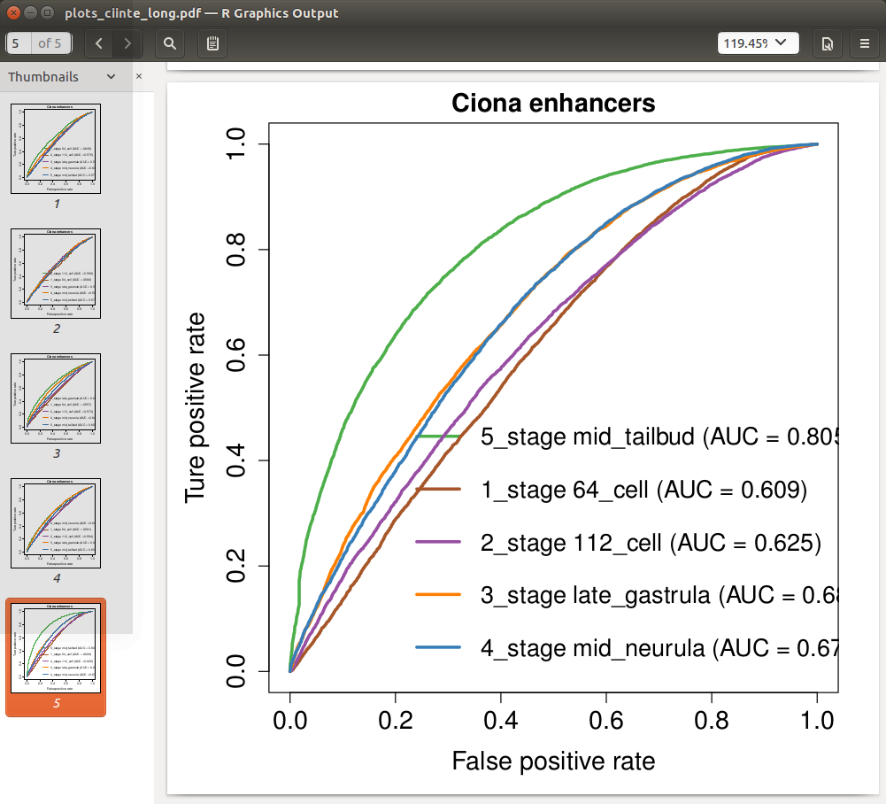
Step 3: Check if algorithm can recognize stage-specific regulatory sequences

Slide 46
Step 3: Check if algorithm can recognize stage-specific regulatory sequences

Slide 47
Step 3: Check if algorithm can recognize stage-specific regulatory sequences

Slide 48
Step 3: Check if algorithm can recognize stage-specific regulatory sequences
Curves that are presented in this presentation are called ‘ROC’ curves and they are used to show performance of the algorithm.

Slide 49
Step 3: Check if algorithm can recognize stage-specific sequences
Curves that are presented in this presentation are called ‘ROC’ curves and they are used to show performance of the algorithm.
Algorithm is first trained and tested on the same dataset 5 times (cross-fold validation)

Slide 50
Step 3: Check if algorithm can recognize stage-specific regulatory sequences
Curves that are presented in this presentation are called ‘ROC’ curves and they are used to show performance of the algorithm.
Algorithm is first trained and tested on the same dataset 5 times (cross-fold validation)
Next, algorithm is also tested on data from other stages.

Slide 51
Step 3: Check if algorithm can recognize stage-specific regulatory sequences
Curves that are presented in this presentation are called ‘ROC’ curves and they are used to show performance of the algorithm.
Algorithm is first trained and tested on the same dataset 5 times (cross-fold validation)
Next, algorithm is also tested on data from other stages.

Slide 52
Step 3: Check if algorithm can recognize stage-specific regulatory sequences

Slide 58
Overall performance: seems fine.
0.661 | 0.57 | 0.594 | 0.574 | 0.454
0.593 | 0.677 | 0.557 | 0.568 | 0.486
0.612 | 0.618 | 0.71 | 0.553 | 0.504
0.595 | 0.553 | 0.662 | 0.70 | 0.63
0.609 | 0.625 | 0.63 | 0.67 | 0.805

Slide 59
Step 4: Reconstruct ancestral genome

Slide 60
Progressive Cactus

Slide 61
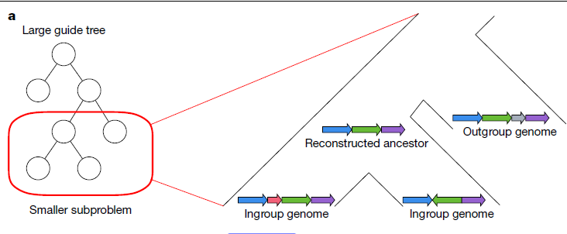
Progressive Cactus at work:
(Armstrong et al., 2020)

Slide 62
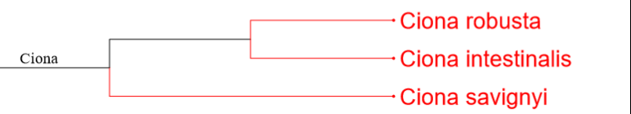
Build the Ancestral Genome

Slide 63
ATAATCAATATAT - Ciona intestinalis (sister species)
ATAATCGATGTAT- Ciona robusta (sister species)
ATAAAAAAAAAAT - Ciona savignyi (outgroup)
ATAATCAATATAT - - ancestor of ciinte/crobu

Slide 64
ATAATCAATATAT - Ciona intestinalis (sister species)
ATAATCGATGTAT- Ciona robusta (sister species)
ATAAAAAAAAAAT - Ciona savignyi (outgroup)
ATAATCAATATAT - - ancestor of ciinte/crobu

Slide 65
Examples of progressive cactus output:
ATAATCAATATAT - Ciona intestinalis (sister species)
ATAATCGATGTAT- Ciona robusta (sister species)
ATAAAAAAAAAAT - Ciona savignyi (outgroup)
ATAATCAATATAT - - ancestor of cinte/crobu

Slide 66
Ancestral genomes can be confusing too:
TCAGCATTGTCGAATGCTATGATC - Ancestor
NCANNATTNTCNNATGNTATGATC - Ciona Intestinalis
TCAGCATTGTCGAATGCTATGATC - Ciona robusta
TCGGGGTCATCAAACGCCATCAAC - Ciona savignyi
GATATTTAATGACATTCCGATATTTAACCAATTTT - Ancestor
GACATTTAATGACATTCCGATATTTAACCAATTTT - Ciona intestinalis
GATATTTAATGACATTCCAATATTTAACCAATTTT - Ciona intestinalis (duplicant)
GATATCGAGTGAAACATTTTTATTTTTTCTATTTT - Ciona savignyi
MISSING SEQUENCE/ DELETION- Ciona robusta

Slide 67
Steps to calculate positive selection:
Find stage-specific regulatory elements (using ATAC/DNA-seq data)
Generate random enhancer sequences
Train the network to recognize stage-specific sequences
Reconstruct the ancestral genome
Train the model on ancestral genome and sister-species genomes
Ta da!

Slide 68
Steps to calculate positive selection:
Find stage-specific regulatory elements (using ATAC/DNA-seq data)
Generate random enhancer sequences
Train the network to recognize stage-specific sequences
Reconstruct the ancestral genome
Train the model on ancestral genome and sister-species genomes
Ta da!
Thesis writing stage..

Slide 69
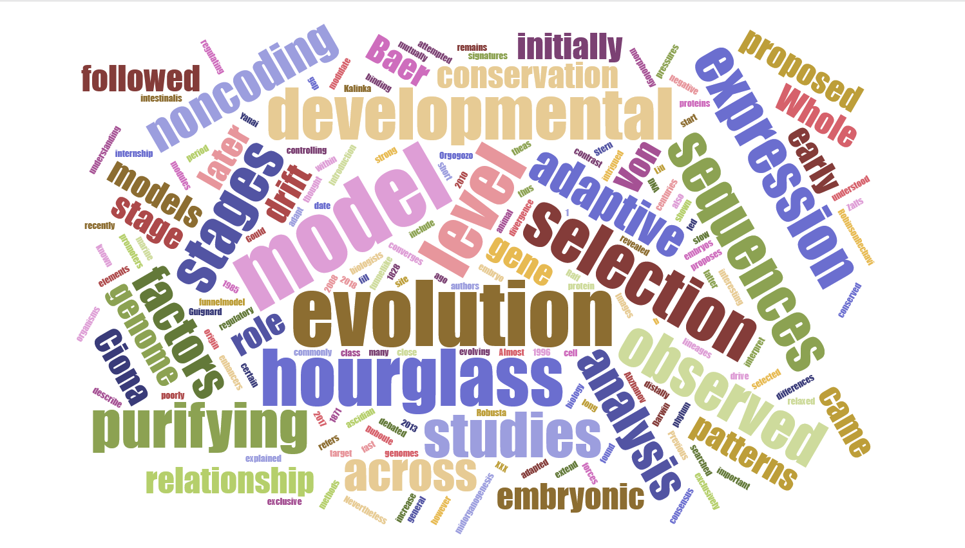

Slide 70
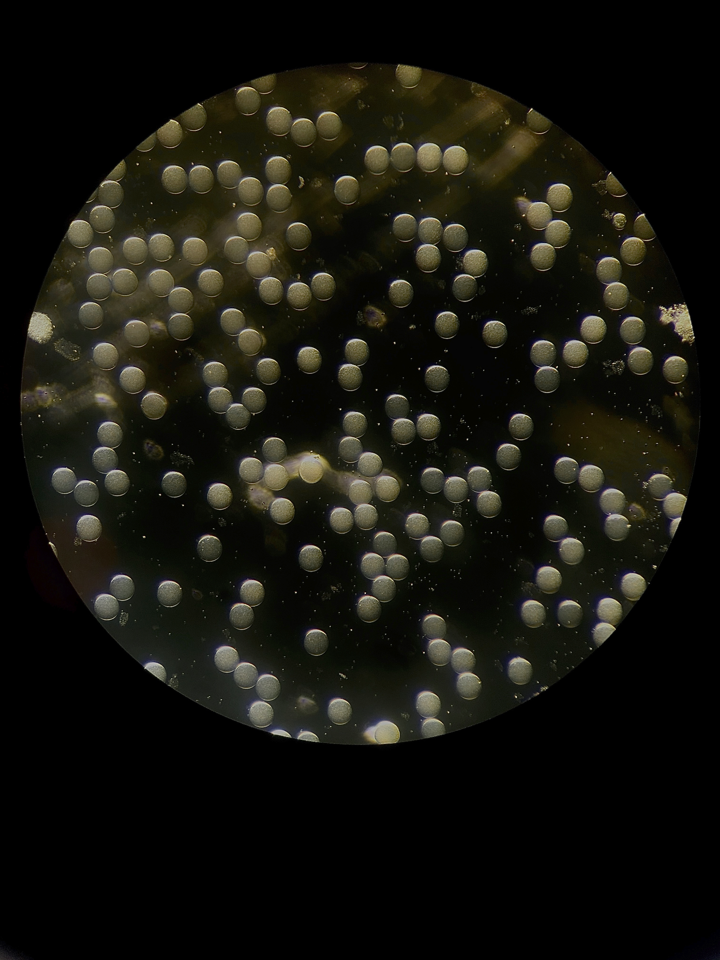
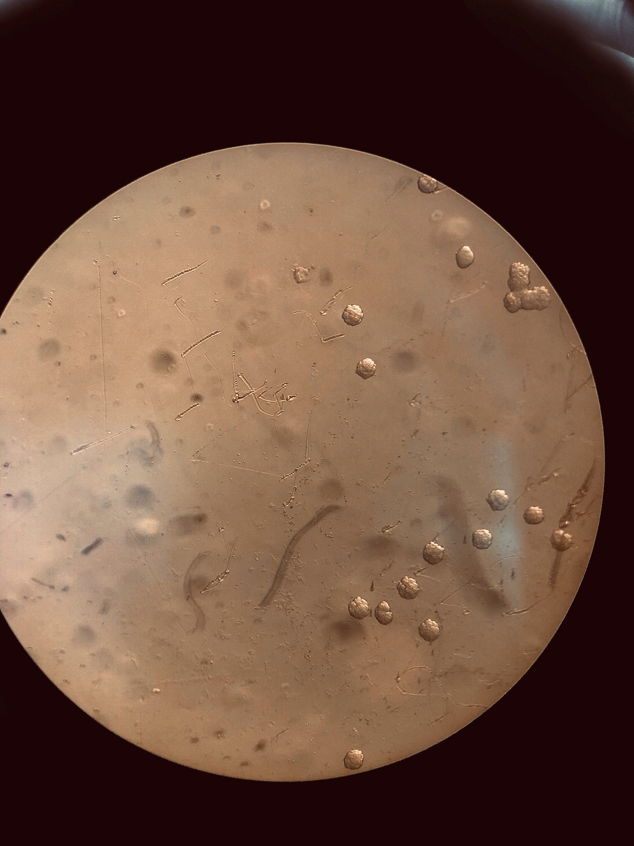

Slide 71
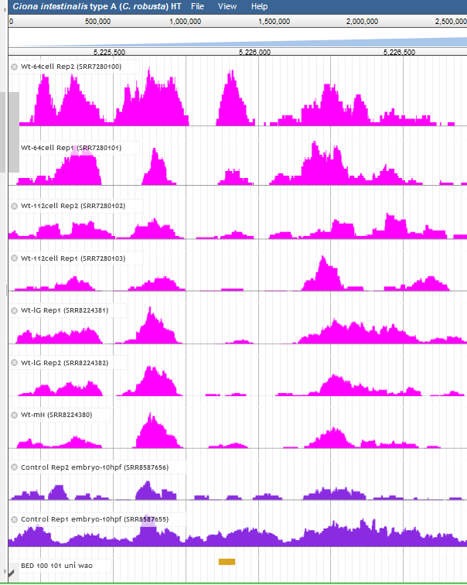
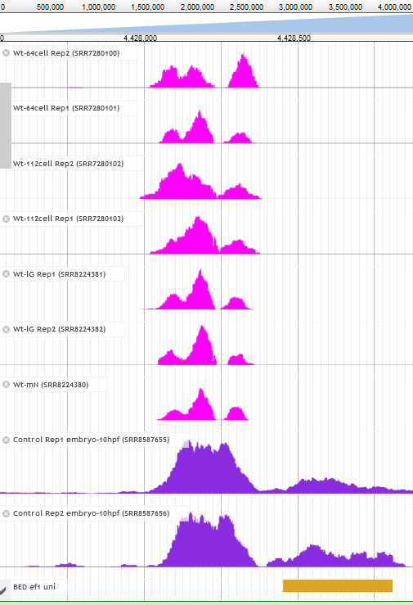
Supplementary slides:

Slide 73
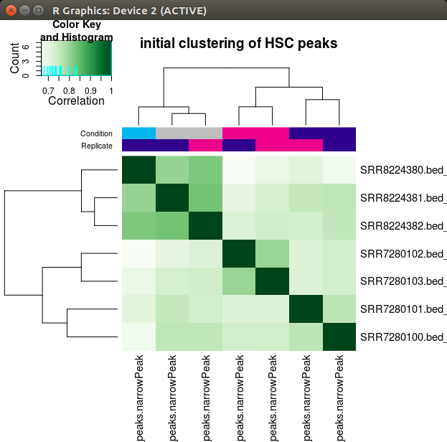

Slide 74
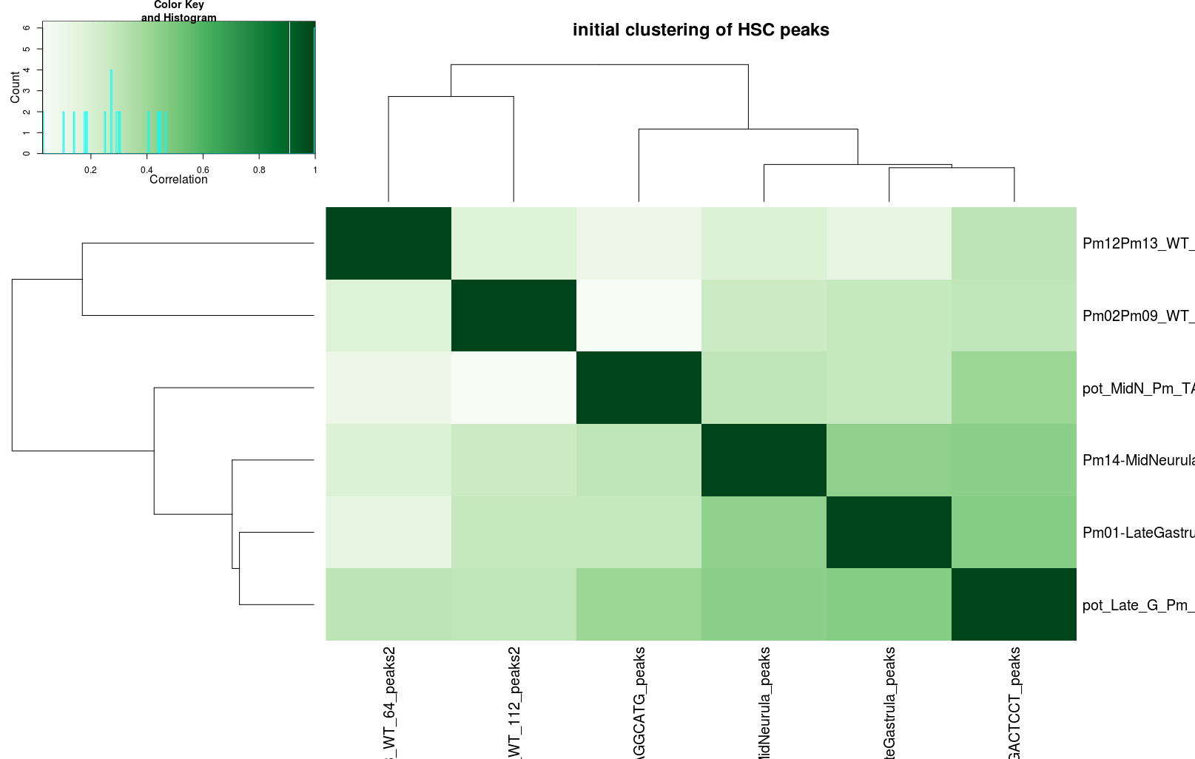

Slide 76
If you had just one slide what would you say?
I don’t want to frame my question as weather there is an hourglass pattern or not

Slide 77

Progressive Cactus
Notes:
Some space for drama ;)

